Slide 1
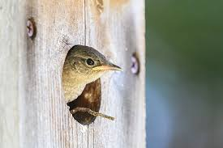
CHORDATES : (AVES)
PENGUINES:
Any warm-blooded vertebrate of the class Aves, having a body covered with feathers, forelimbs modified into wings, scaly legs, a beak, and no teeth, and bearing young in a hard-shelled egg are known as Birds / Aves.
Based on flying there are two types of birds
Birds who can fly
Birds who can’t fly
PRESENTATION BY
SUSANTA SARKAR
Penguins are non-flying type, carnivorous birds/aves. There are total 18 species of penguins alive in the world in which emperor penguins are the tallest and heaviest of all living penguin species. The male and female are also similar in plumage and size.
Penguins are non-flying type, carnivorous birds/aves. There are total 18 species of penguins alive in the world in which emperor penguins are the tallest and heaviest of all living penguin species. The male and female are also similar in plumage and size.

Slide 2
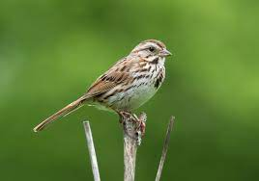
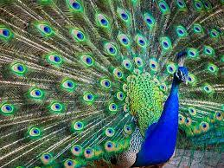
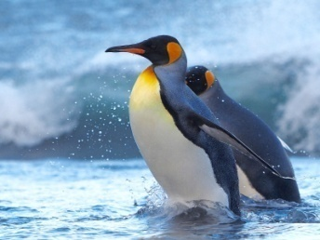
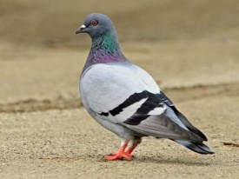
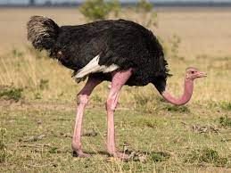
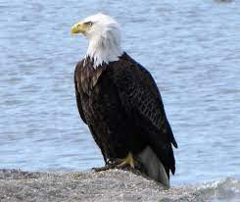
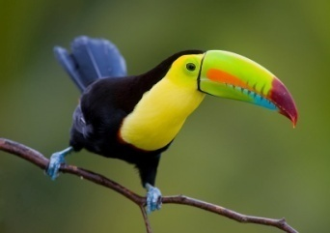
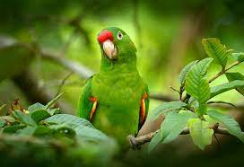
PENGUINS:
Penguins are non-flying type, carnivorous birds/aves. There are total 18 species of penguins alive in the world in which emperor penguins are the tallest and heaviest of all living penguin species. The male and female are also similar in plumage and size.
SOME WELL KNOWN AVES ARE

Slide 3
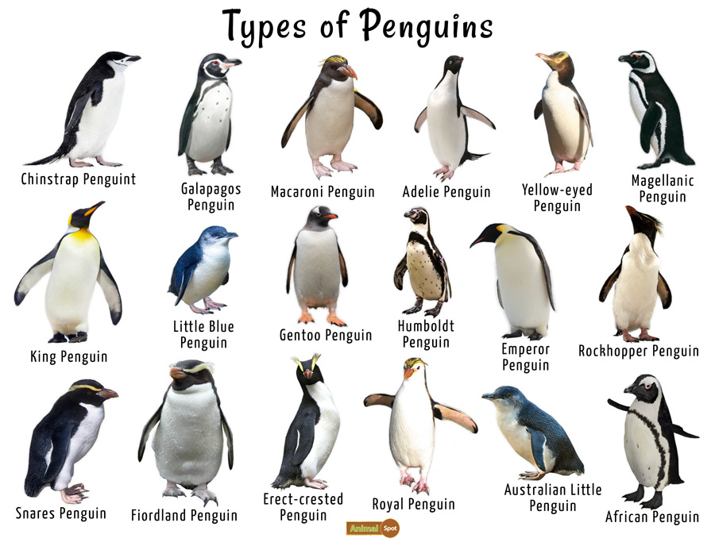
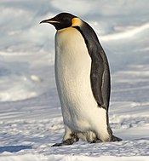
Systematic position (Acc. To J.Z. Young, 1981)
Kingdom: Animalia
Phylum: Chordata
Class: Aves
Order: Sphenisciformes
Family: Spheniscidae
Genus: Aptenodytes
Species: Aptenodytes forsteri
Emperor penguin (Aptenodytes forsteri)
Habitat - Wild Emperor penguins are only found in Antarctica.
Height - About 1.1 -1.3m (Adult)
Weight - About 22.7 – 45.4 kg (Male’s weight is more than female)
There are total 18 species of penguin alive in the world

Slide 4
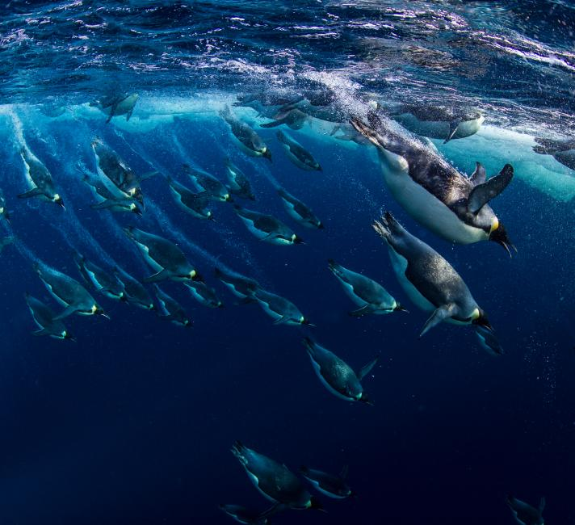
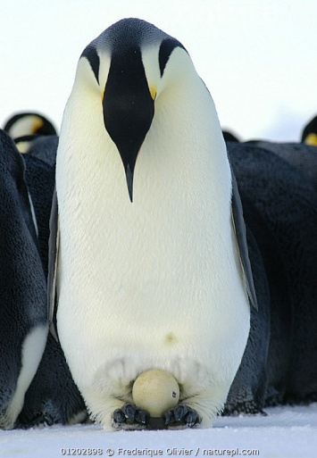
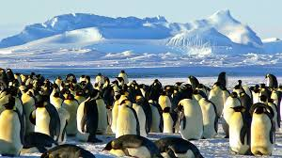
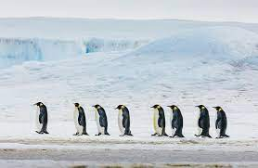
General behavior
Colonial nesting : Emperor penguins exhibit a unique colonial nesting behaviour, forming large breeding colonies during the Antarctic winter to protect against the extreme cold.
2. Cooperative Breeding: Both parents actively participate in incubating the egg, taking turns to keep it warm by balancing it on their feet. This cooperative breeding strategy enhances the chances of chick survival.
3. Long-distance Travel: Emperor penguins are known for their impressive long-distance travel during the breeding season. They can cover significant distances on foot, sometimes trekking over 100 kilometres to reach their breeding grounds.
4. Deep Diving: Exceptional divers, emperor penguins can plunge to remarkable depths while hunting for food. They are capable of diving to depths of over 500 meters, relying on their streamlined bodies and efficient swimming techniques.
The brooding and nesting period for emperor penguins runs from August through to late November.

Slide 5
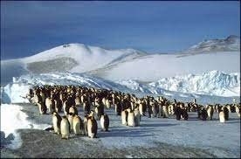
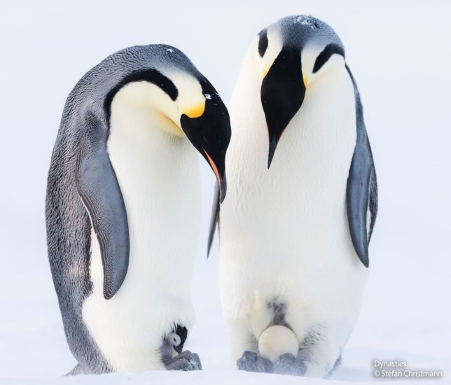
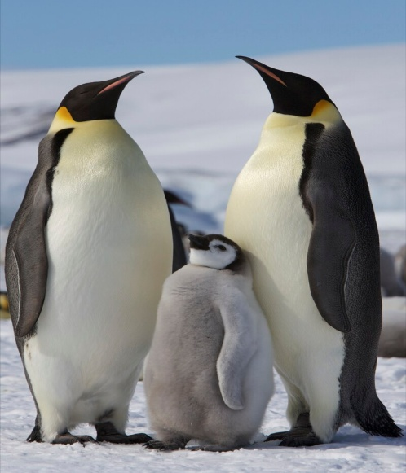
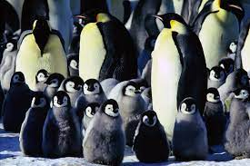
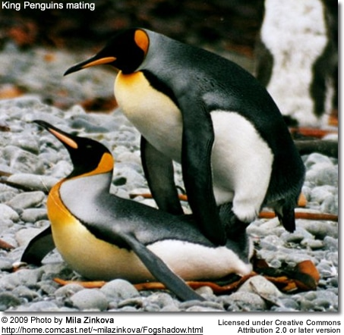
Breeding habit (MARCH TO APRIL)
Colonial Nesting:
Emperor penguins breed in large colonies during the Antarctic winter, where thousands gather on ice shelves to form breeding colonies.
Courtship and Mating Rituals:
Mating begins with elaborate courtship rituals, involving vocal calls, head movements, and displays to attract a mate. Once paired, they engage in copulation, which occurs mainly through a unique "cloacal kiss."
Egg Incubation:
After mating, the female lays a single egg and transfers it to the male, who incubates it by balancing it on his feet, covered by a specialized brood pouch, while the female returns to the sea to feed.
Shared Parental Care:
Both parents take turns incubating the egg and protecting it from the harsh Antarctic conditions. This shared parental care is crucial for the survival of the chick, which hatches after about two months.
They are monogamous so they find a mating partner while colonial nesting

Slide 6
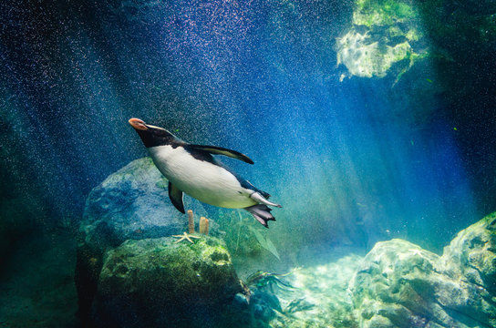
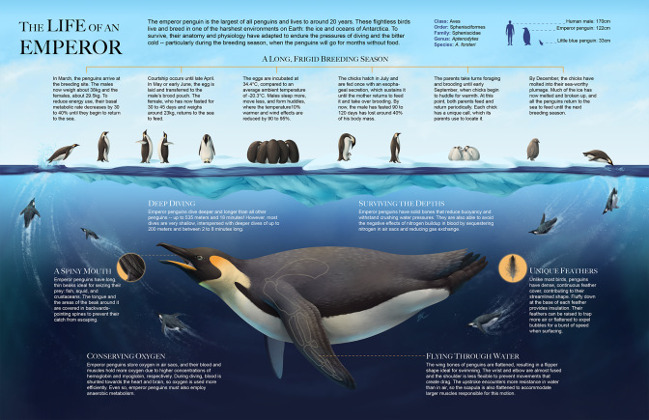
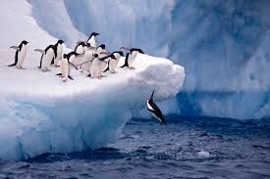
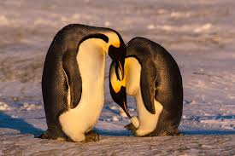
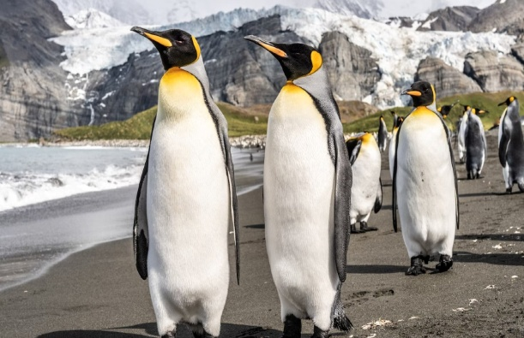
Feeding habit (carnivorous birds)
Foraging Dives:
Emperor penguins are adept divers, capable of reaching depths of over 500 meters. They primarily feed on fish, squid, and krill during their foraging dives, which can last for extended periods, often exceeding 20 minutes.
Energy Conservation:
To maximize energy efficiency during hunting, emperor penguins often travel considerable distances beneath the ice, relying on their streamlined bodies and powerful swimming abilities to catch prey. This behavior helps them conserve energy for the demanding breeding season.
Feeding During Breeding:
While breeding, male emperor penguins undertake the responsibility of incubating the eggs. During this period, they rely on stored energy from their earlier feeding trips, fasting for up to two months. Once the chicks hatch, both parents contribute to feeding them, regurgitating food sourced from the ocean.
Efficient Hunting Strategy:
Emperor penguins exhibit a cooperative hunting strategy. They often form groups and coordinate their movements to corral schools of fish or other prey, making it easier for each penguin to catch food. This collaborative approach enhances their overall hunting success in the harsh Antarctic environment.

Slide 7
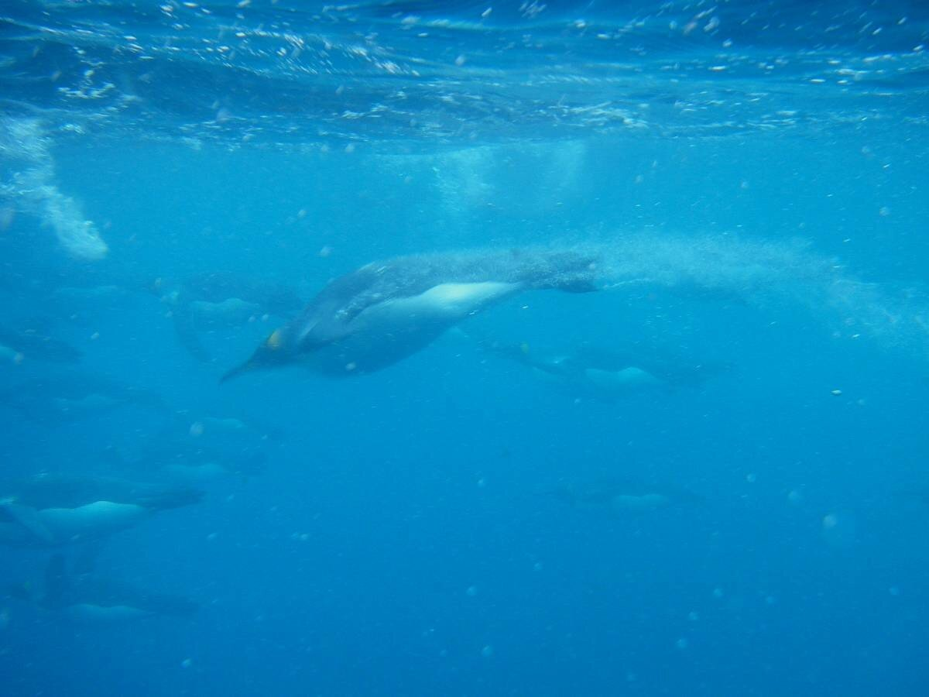
ACKNOWLEDGEMENT
In the accomplishment of completion of my project on the Emperor penguin , I would like to convey my special gratitude to the respected professors of Department of Zoology, Bangabasi Morning College. Their valuable guidance and suggestions helped me in various phases of the completion of this project. I will always be thankful to them in this regard.
Information compiled and presented by,
Susanta Sarkar
B.Sc(H)(Sem III), Dept of Zoology
Bangabasi Morning College
C.U. roll no: 223144-21-0039
C.U. Regn. No: 144-1111-0332-22

Slide 8
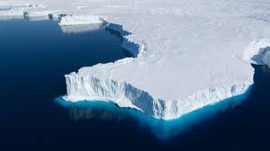
THANK YOU

